Slide 1
Glance at Sparseloop artifact
What experiments are included in the artifact?

Slide 2
Overview
The artifact link: Accelergy-Project/micro22-sparseloop-artifact: MICRO22 artifact evaluation for Sparseloop (github.com)
The source code of Sparseloop is at: https://github.com/NVlabs/timeloop/tree/1eb0fd0a62fea1f3df4580a1b6c7ae6238772fbb
The Sparseloop paper is at: Sparseloop: An Analytical, Energy-Focused Design Space Exploration Methodology for Sparse Tensor Accelerators | IEEE Conference Publication | IEEE Xplore
To run the artifact, docker is required.
The artifact includes 5 experiments, along with its result illustration.

Slide 3
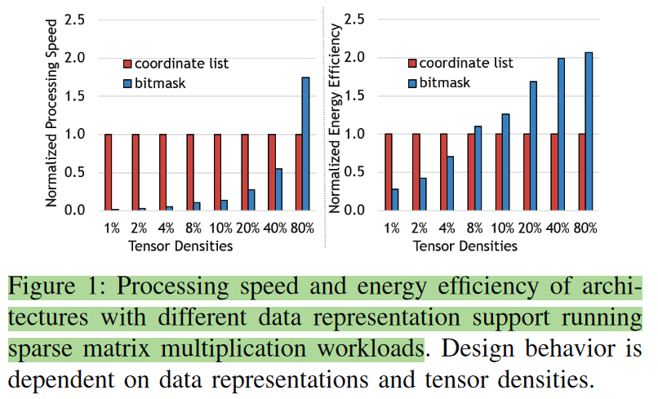
Speedup illustration of different compression format (Fig. 1 in the paper)
This experiment is not for model validation.
The output will be the figure on the left.
Not checked the code yet.

Slide 4
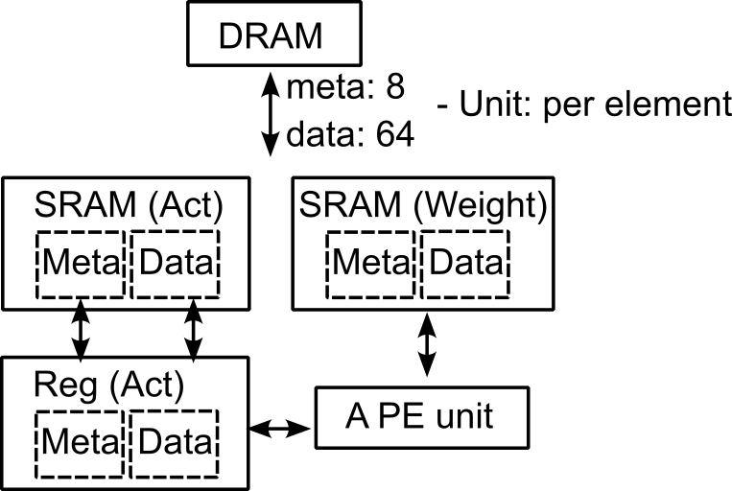
2. Single PE behavior validation (Fig. 12 in the paper)
This experiment is to show the computing cycle count is the same as the baseline, considering the sparsity impact.
The hardware template is shown on the left.
Note:
It’s a single PE system.
Memory port width is setted to be big enough so that there is no memory stalling.
The workload is set to be conv layers. The default distribution has been set to hypergeometric.
Though the author said it’s a Eyeriss V2 system, the architecture is totally different.

Slide 5
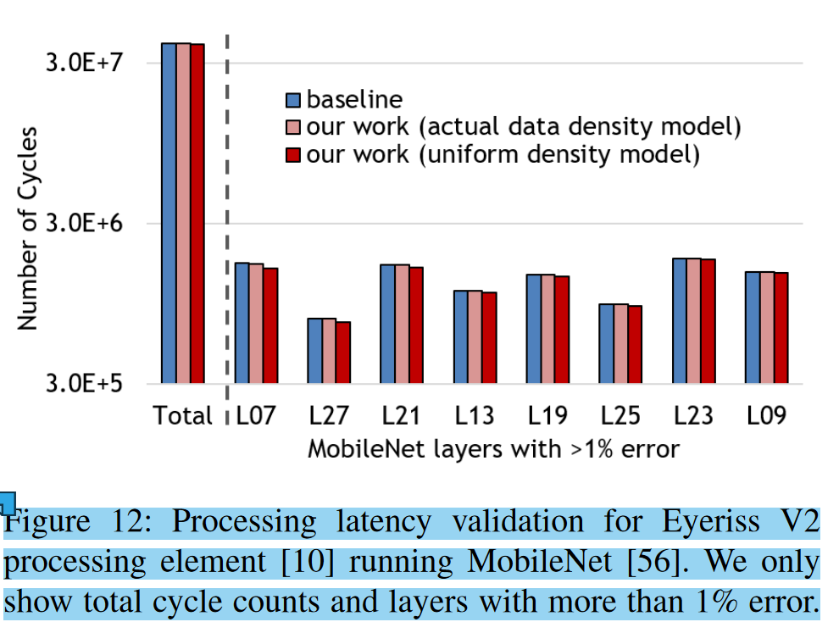
2. Single PE behavior validation (Fig. 12 in the paper)
The script will generate the figure on the left.
Cycle count calculation (my guess):
#cycle = #layer_size × density(act) × density (weight)
Source of mismatch against baseline:
Density of MAC operation does not exactly equal to density(act) × density (weight).
Unclear explanation:
Source of the baseline is not explained.
How the second bar (actual data density model) is generated is not explained.

Slide 6
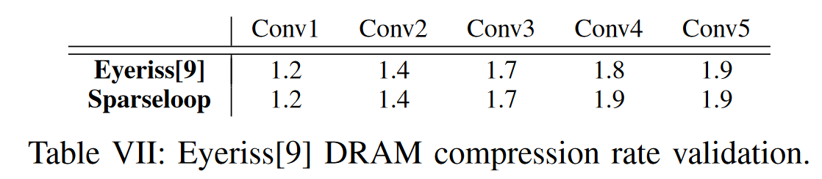
3. DRAM access count compression ratio (Table 7 in the paper)
This experiment is to show the access count reduction on DRAM level after applying the sparsity feature.
The formula used to calculate the compression ratio is:
From the Sparseloop output, read out #weight_access, #act_access, #output_access for DRAM.
Read out #access (dense) from baseline files.
If activation density > 0.9:
#access (sparse) = #weight_access + #act_access + #output_access/0.76
else:
#access (sparse) = #weight_access + #act_access/0.76 + #output_access/0.76
ratio = #access (dense) / #access (sparse)
Unclear points:
The source of 0.76 is not explained. Though the code in-line comment explains it is used to cover the metadata overhead, it is weird that it is not included within the framework and requires post-processing in the script.

Slide 7
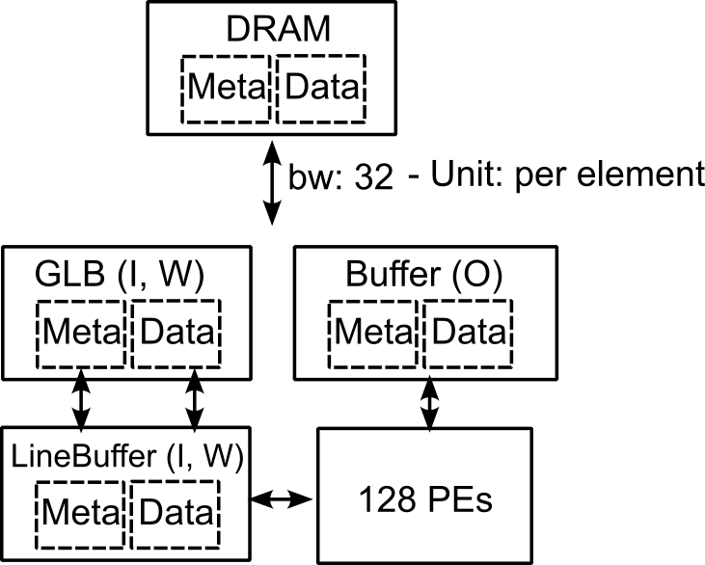
4. DSTC validation (Fig. 13 in the paper)
This experiment is to show the validation result on cycle count against DSTC chip.
The baseline is claimed to be collected from Fig. 21 in DSTC paper.
The hardware template is on the left. The workload is general matrix multiplication. The density distribution is assumed to be hypergeometric.

Slide 8
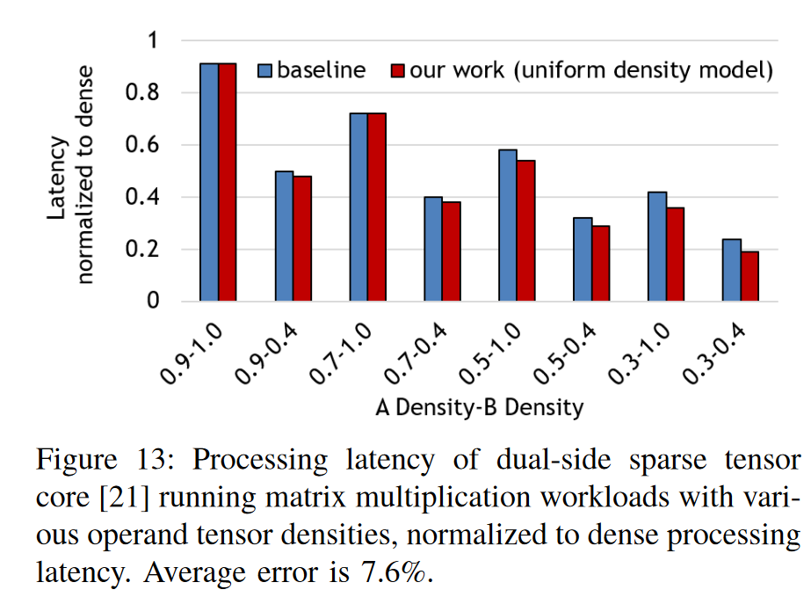
4. DSTC validation (Fig. 13 in the paper)
The script will output the left figure.
Note:
The normalized ratio for red bar is calculated as:
Derive the #cycle (dense) when both matrices are dense.
Derive the #cycle (sparse) when matrices are sparse.
ratio = #cycle (sparse) / #cycle (dense)
The normalization is not normalized to the #cycle reported in DSTC paper, which is not explained in the paper.

Slide 9
4. DSTC validation (Fig. 13 in the paper)
Unclear points:
The total latency is calculated based on the average utilized #PEs. But how #PEs is calculated is unclear.
Utilized #PEs will be different if setting with different distributions (fixed, hypergeometric, banded). Not sure how the calculation is done for each distribution.

Slide 10
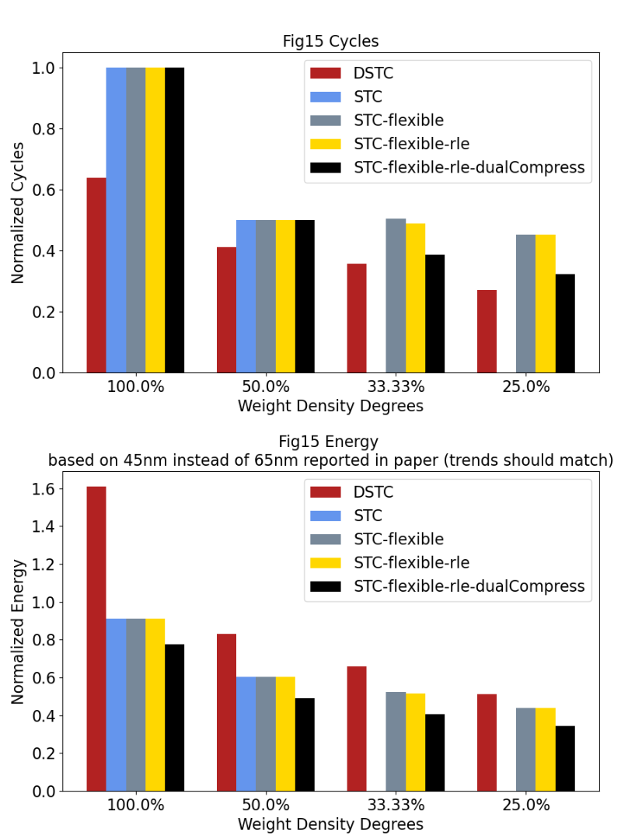
5. Normalized cycle/energy illustration on different works (Fig. 15 in the paper)
This is not an experiment for validation.
The output will be the figure on the left.
Not checked the code in detail, so not understand what the code is doing yet.

